Slide 1
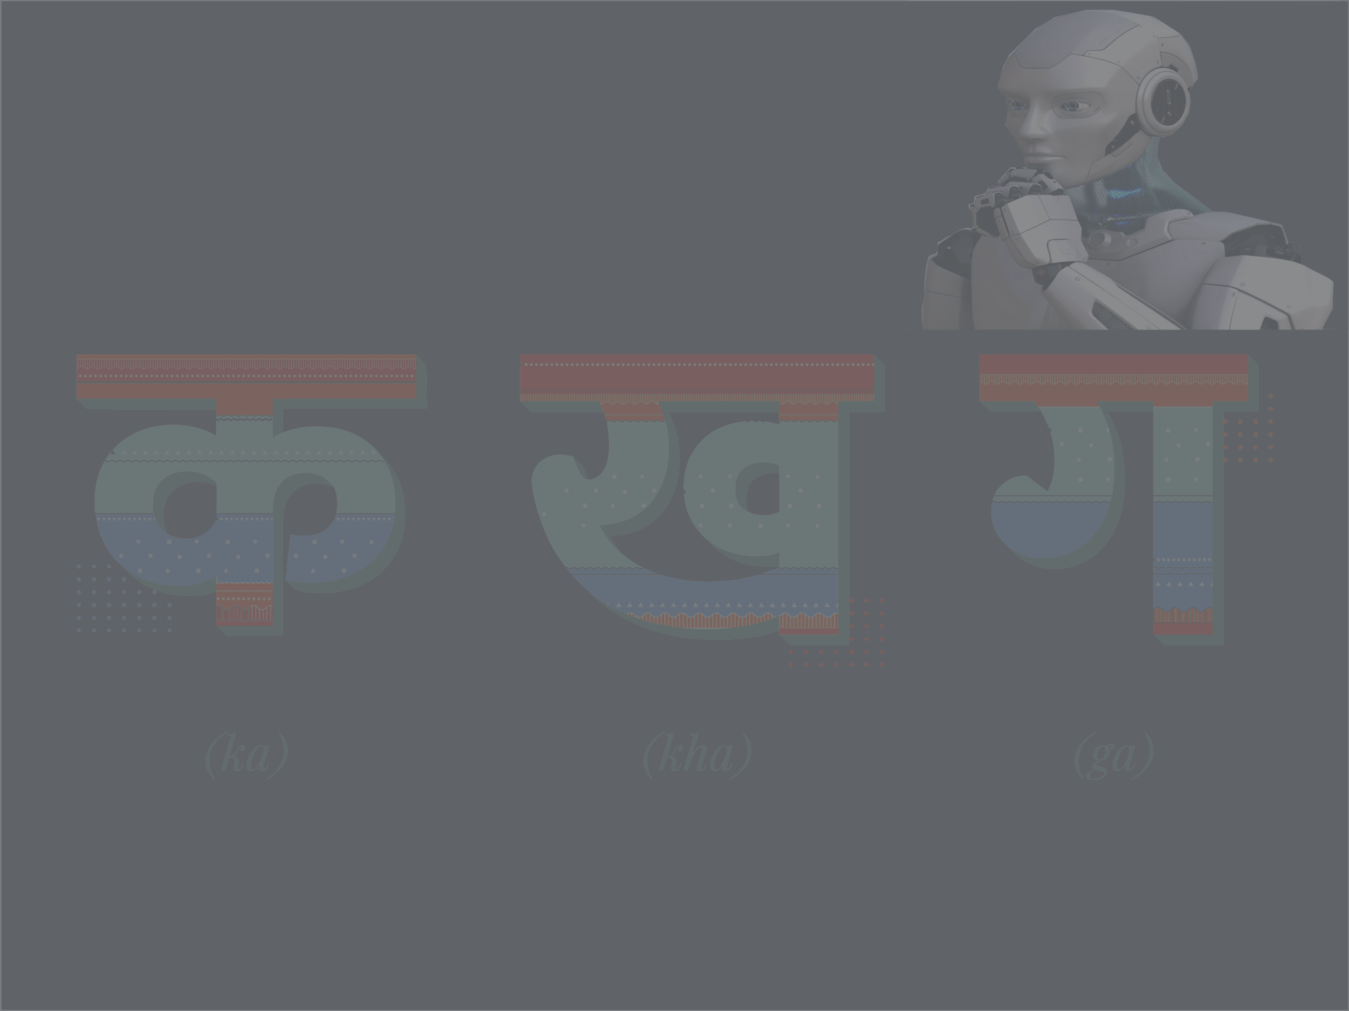
Devanagari Handwritten Character Recognition
Sanjay Jaras
Bellevue University

